Slide 1
An Interesting Collapse
(or Why You Should Do Backups)
Bob Eager

Slide 2
What’s this about?
It’s about a rather unfortunate episode in the history of the University…
It all started back in 1830 or thereabouts…!
  someone decided to build a railway line between Canterbury and Whitstable
  this was to be the first self propelled passenger railway in the world
  to take residents of Canterbury from North Lane (near the Westgate) to Whitstable harbour, thence to catch the boat to London
the line ran across Forty Acres Road, and under the future site of the University
there were (and still are) tunnel entrances in the grounds of the Archbishop’s School, and behind Giles Lane car park
the line worked well, but closed in 1952

Slide 3
the University authorities were aware of the tunnel, but were assured it was stable
but in July 1974 it became very unstable!
...and bad things started to happen....

Slide 4
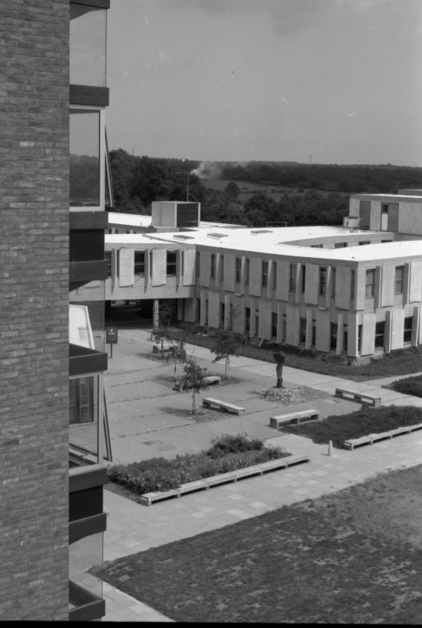
Note the slightly ‘bent’ bridge joining the Cornwallis building to the Gulbenkian Theatre….

Slide 5
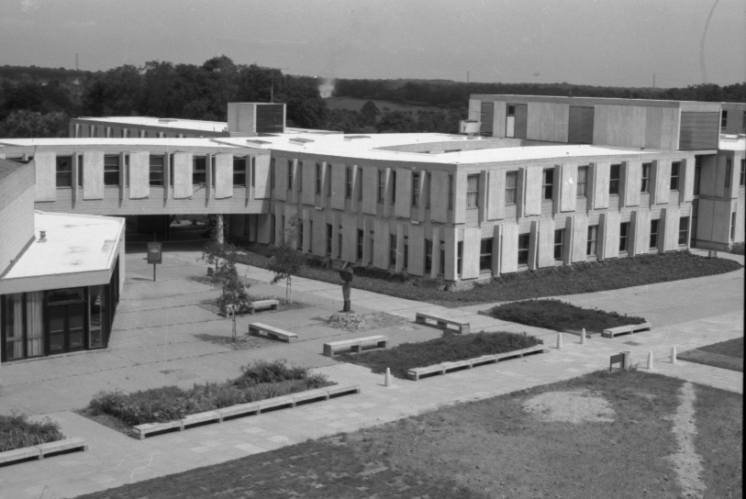
Main Computer Room

Slide 6
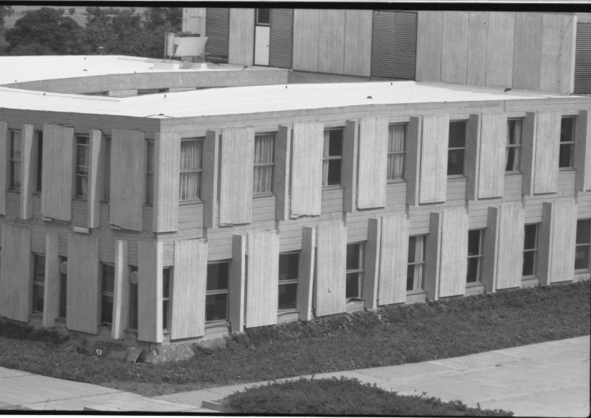
A bit crumpled…..

Slide 7
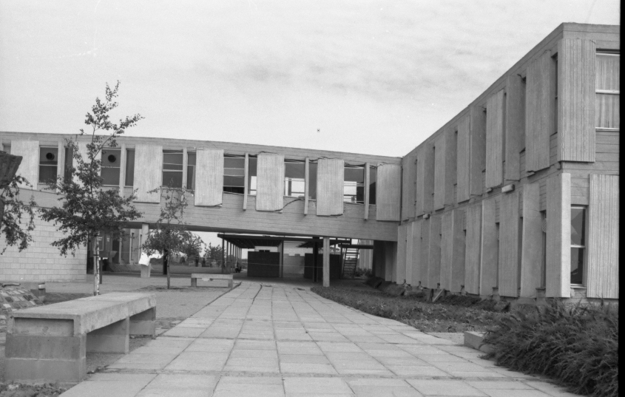
The building on the right sank about 50cm…..

Slide 8
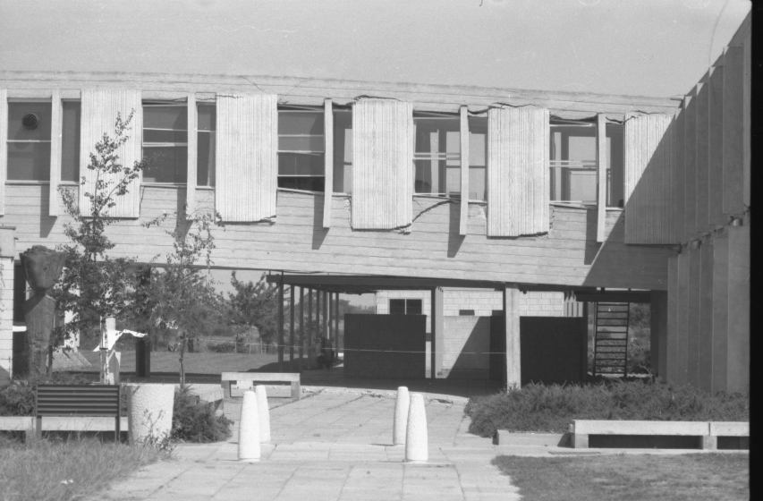
Those were offices….

Slide 9
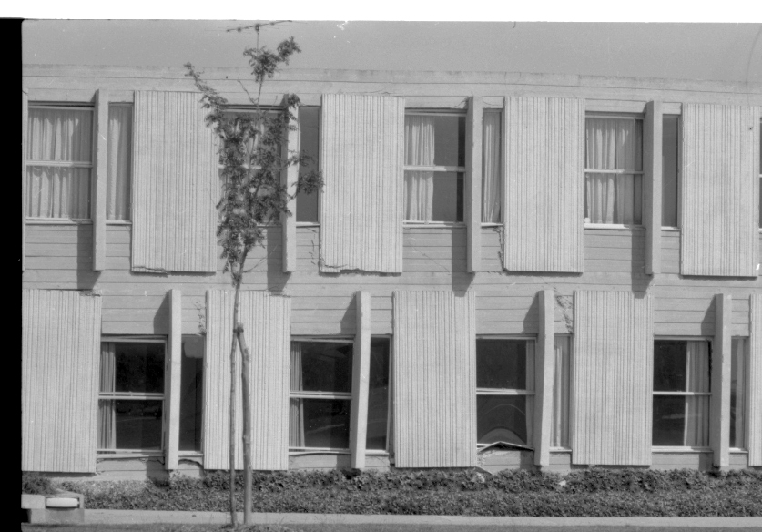
Not all of it sank at the same rate…

Slide 10
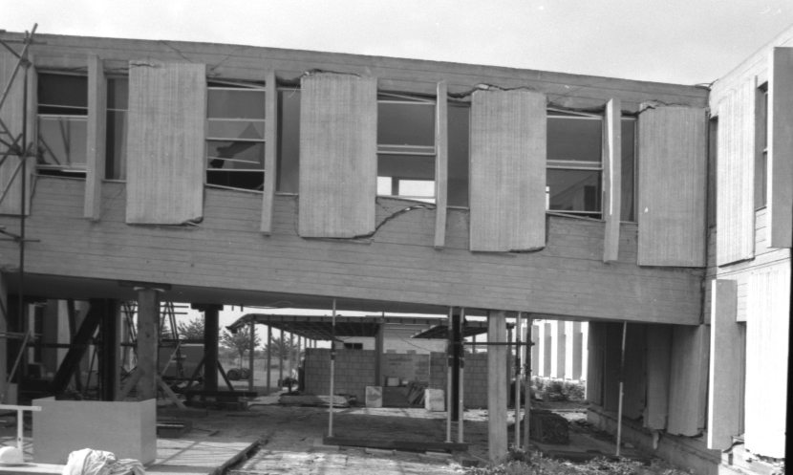
getting worse…

Slide 11
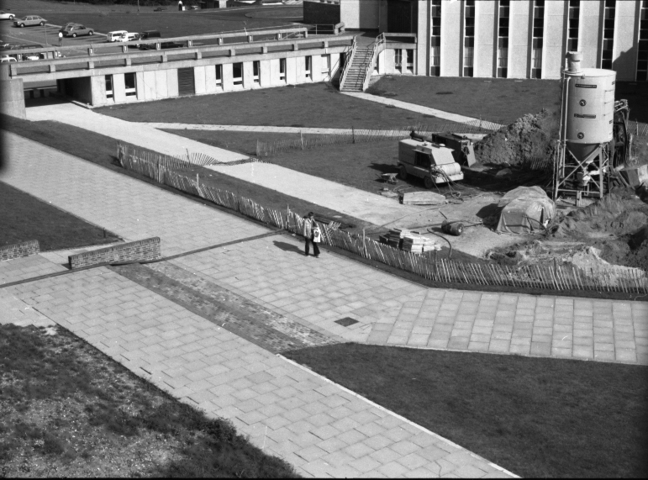
Pumping cement into the tunnel before Rutherford sagged too much…

Slide 12
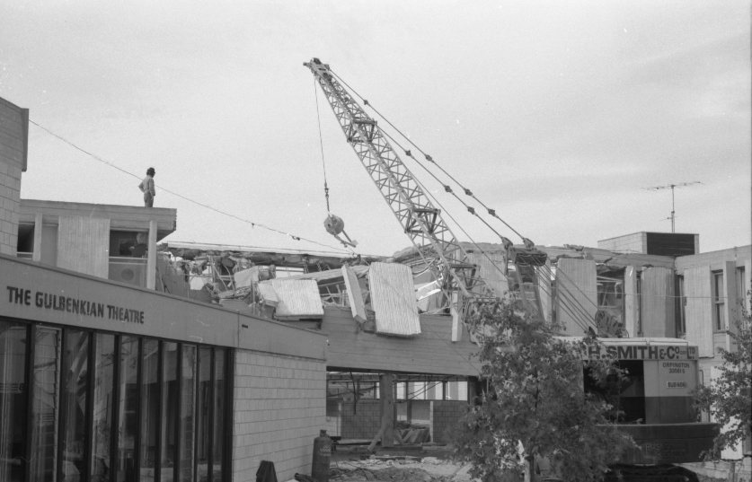
Demolition time…..before it falls down…..

Slide 13
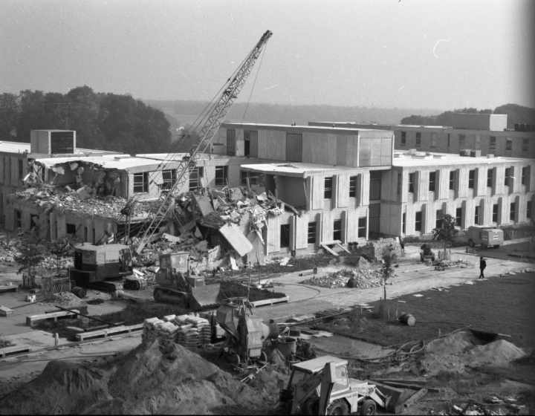
Now you know why that part of the building is asymmetric….

Slide 14
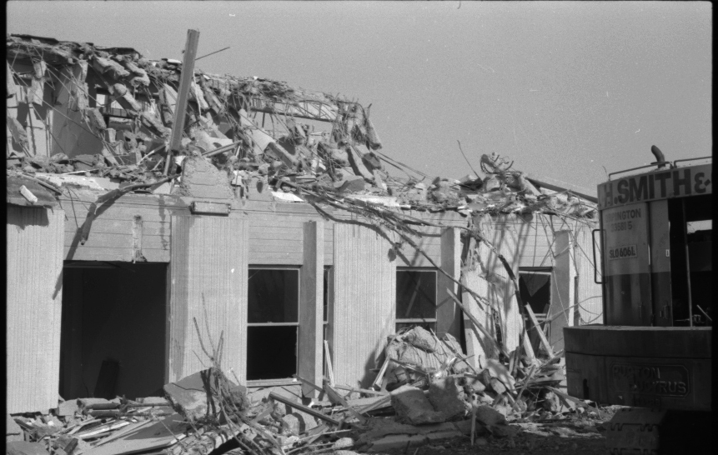
Not a lot left…..

Slide 15
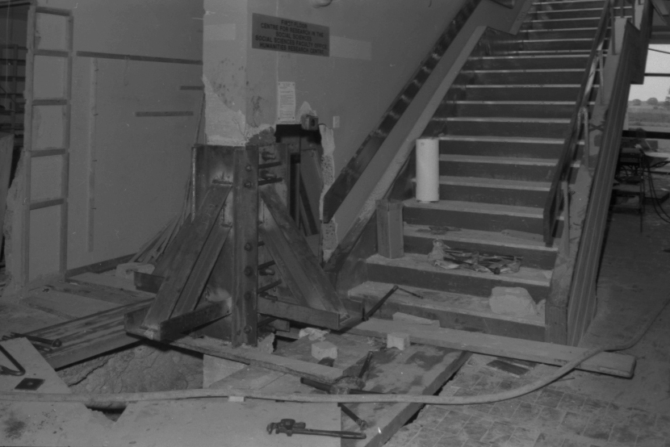
You may recognise the staircase…..

Slide 16
The End

